Slide 1
Inside The Co-Occurrence Recommendation Engine
Brett Lindsley
https://github.com/brett-lindsley

Slide 2
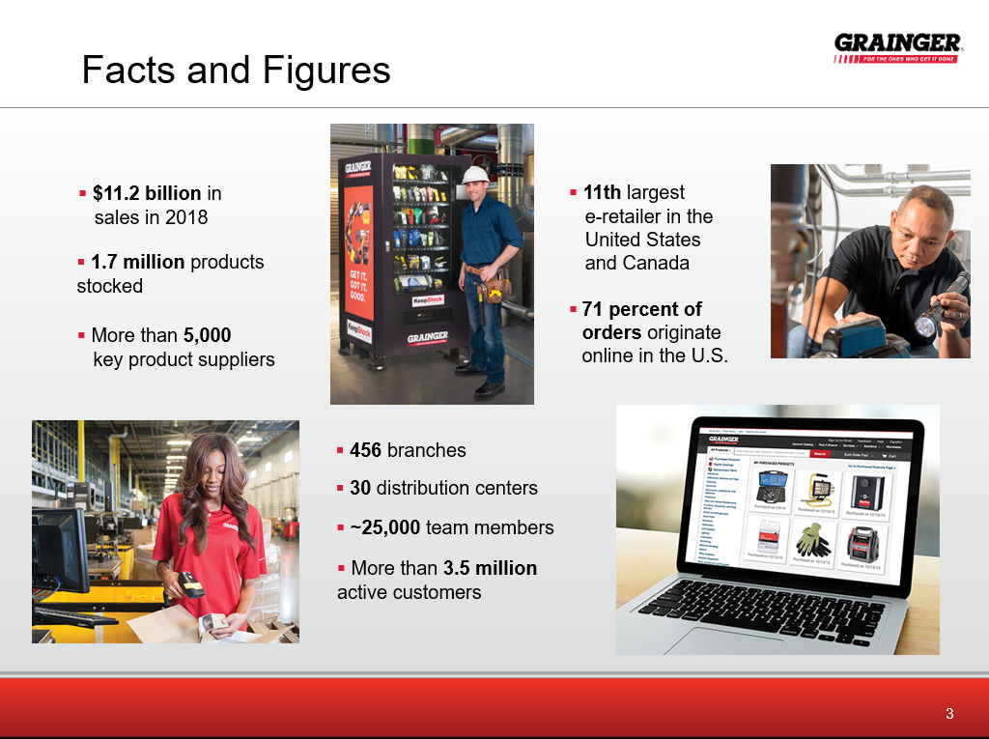

Slide 3


Slide 4
Presentation Objectives
Provide a hands-on intuitive understanding of the algorithms and mathematics.
Example algorithm in Java for details.

Slide 5
Apropos…
Dear enterprise: You are your algorithms, says Gartner
Digital business and big data was a nice warm up act. Now your enterprise is all about the algorithms.
"Algorithmic business is here," said Peter Sondergaard in his opening talk at the Gartner Symposium ITxpo.
"Big data is not where the value is," said Sondergaard. "Algorithms is where the real value lies. Algorithms are where the action lies. Data is dumb. Algorithms define the way the world works."
http://www.zdnet.com/article/dear-enterprise-you-are-your-algorithms-says-gartner/?imm_mid=0da452&cmp=em-data-na-na-newsltr_20151014

Slide 6
References to Ted Dunning
Ted Dunning is the Chief Technology Officer at MapR. https://www.linkedin.com/in/teddunning/
Many presentations on technology, particularly big data and algorithms.
Practical solutions.

Slide 7
Data Processing Trends…
It’s not always about squeezing a few percent of accuracy with very complex algorithms.
Simple algorithms.
More effective use of the data.
Performance.
Scalability.

Slide 8
What is “Recommendation”?
Many different definitions, systems, etc.
We will use
Interactions between an “actor” and an “item”.
Suggest additional interactions that have not yet been observed.
Something the actor may want to do, but does not know it.
Actors: people, machines, equipment, etc.
Realistic difficulties: Many users, many items, but sparse data.

Slide 9









Types Of Recommenders
Read
by user
Buy or Rate
Similar
Buy or Rate
Recommend
Similar
Articles
Recommend
Buy
Content-Based
Filtering
User Collaborative Filtering
Recommend
Item-Based Filtering
Buy

Slide 10
Challenges
Data skew
Very popular items (everybody bought the same thing).
Very popular users (a person that buys everything).
We will need to deal with this…
Normalization.
Finding only anomalous “interesting” relationships.
Data grooming.
What data accurately reflects human preferences?
Unfortunately, human-based ratings does not work well.
Use people’s behavior.
Watching what people do is far more powerful than having them record what they say they like.

Slide 11

Raw Data – Item Interactions
Interactions
Example data set:
4 users.
8 items.
Raw Interactions
user: 0, interaction: 7
user: 0, interaction: 3
user: 3, interaction: 3
user: 0, interaction: 1
user: 0, interaction: 4
user: 3, interaction: 2
user: 2, interaction: 3
user: 3, interaction: 0
user: 1, interaction: 2
user: 2, interaction: 2
user: 1, interaction: 5
user: 2, interaction: 4
user: 1, interaction: 7
user: 2, interaction: 1
user: 3, interaction: 6
Item - 1
Item - 2
Item - 3
User 0
Item - 4
Item - 5
Item - 6
Item - 7
Item - 8
We can see item 7 was interacted with by both users 0 and 1. We can see the set of interactions by a particular user comprise a relationship between those items.
User 1

Slide 12

“A” – The History Matrix
Compress the raw interaction list vertically.
Items
Users
User 0 interacted with items 1, 3, 4, 7 (only one time each).

Slide 13

What Can We Do With The A Matrix?
Consider a current interaction vector h:
A user has interacted with item 4 once.
Users who have interaction “h” (the vector of items we are currently interacting with):
A
Translates items to users.
A^{T}
Translates users to items.
Ah
The users currently interacting with the items.
A^{T}(Ah)
User-centric recommendations – given the users from Ah, what do they recommend.
(A^{T}A)h
Item-centric recommendations – given the co-occurrences of interactions, what do they recommend.

Slide 14

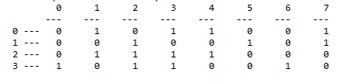
Current User Interactions - Ah
A
h
Ah
Interaction
User
*
=
Raw Interactions
user: 0, interaction: 7
user: 0, interaction: 3
user: 3, interaction: 3
user: 0, interaction: 1
user: 0, interaction: 4
user: 3, interaction: 2
user: 2, interaction: 3
user: 3, interaction: 0
user: 1, interaction: 2
user: 2, interaction: 2
user: 1, interaction: 5
user: 2, interaction: 4
user: 1, interaction: 7
user: 2, interaction: 1
user: 3, interaction: 6
An arbitrary user has interacted with item 4 once.
Users 0 and 2 have interacted with item 4 one time each.

Slide 15
User-Centric Recommendations
A^{T}(Ah)

Slide 16
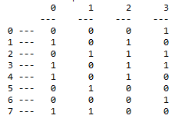

User Centric Recommendation A^{T}(Ah)
*
=
User 0 interactions -> 1, 3, 4, 7
User 2 interactions -> 1, 2, 3, 4
A^{T}
Ah
Raw Interactions
user: 0, interaction: 7
user: 0, interaction: 3
user: 3, interaction: 3
user: 0, interaction: 1
user: 0, interaction: 4
user: 3, interaction: 2
user: 2, interaction: 3
user: 3, interaction: 0
user: 1, interaction: 2
user: 2, interaction: 2
user: 1, interaction: 5
user: 2, interaction: 4
user: 1, interaction: 7
user: 2, interaction: 1
user: 3, interaction: 6
Item
Recommendation Weight
This is interesting, a current interaction with item 4 (the “h”) shows us that two users (0,2) have interacted with item 4 (Ah) once, thus, the combined interactions/recommendations of both users is items (1, 2, 3, 4, 7) with various weights.

Slide 17
User vs Item Recommender Performance
A – [U x I] size matrix
A^{T} – [I x U] size matrix
h – [I x 1] size matrix
User Centric
Item Centric
A^{T}(Ah)
[I x U] ([U x I] [I x 1])
[I x U] [U x 1]
[I x 1]
(A^{T}A)h
([I x U] [U x I]) [I x 1]
[I x I][I x 1]
[I x 1]
The real-time computation with the user vector (multiply in parenthesis) must be done first.
No way to pre-compute.
Slower response time.
Precompute the part in parenthesis.
May be done off-line (e.g. overnight).
Only the recommendation for the smaller user vector needs to be done in real-time.

Slide 18
Item-Centric Recommendations Using Co-Occurrence
(A^{T}A)h

Slide 19
Co-Occurrence Recommendation
New recommendations are based on similar past behaviors (not similar users).
Easy to understand. Java simulation is 10 pages.
Easy to implement. Can be implemented on a microcontroller.
Extensible
E.g. multi-modal recommendation of music with movies.
Can be used for streaming recommendations. Incremental updates rather than re-computation.
Efficient.
Excellent results compared to complex systems.

Slide 20
Co-Occurrence Matrix- What is it?
A simple way to represent events that occur together.
Simple mathematics – easy to compute.
Indicates for each item pair, how many users interacted with it.
Steps
Raw data.
History matrix (A).
Co-occurrence matrix (C).

Slide 21

(A^{T}A) – The Co-Occurrence Matrix
C = A^{T}A
*
A^{T}
A

Slide 22
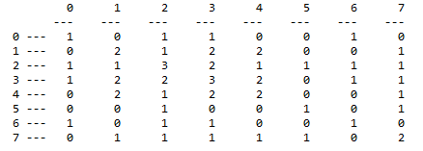
What Does C Tell Us?
Raw Interactions
user: 0, interaction: 7
user: 0, interaction: 3
user: 3, interaction: 3
user: 0, interaction: 1
user: 0, interaction: 4
user: 3, interaction: 2
user: 2, interaction: 3
user: 3, interaction: 0
user: 1, interaction: 2
user: 2, interaction: 2
user: 1, interaction: 5
user: 2, interaction: 4
user: 1, interaction: 7
user: 2, interaction: 1
user: 3, interaction: 6
There were 2 users that had interactions with both (3, 4).

Slide 23
Two Types of Recommenders Using Co-Occurrence
Current Interaction Recommender
Recommends based on current interactions.
Typically the current product basket, but can be extended to other “modes” such as product views, purchases, share with friends, etc.
Anomalous Relationship Recommender
Recommends based on interesting associations to a specific product.
Typically a current product view, could be associations to all products in a basket, etc.

Slide 24
Co-Occurrence Recommender Systems
Current Interaction Recommender
Search
Engine
Product
Request
Product Request
(current interaction)
Item
Metadata
Web
Tier
Product
Information
Product Information,
Recommendations
Product
Request
User
Interaction
Batch Create
Co-occurrence
Generate Item Recommendations
Item recommendations
Anomalous Relationship Recommender
Search
Engine
Product
Request
Product Request
Item
Metadata
Web
Tier
Product
Information,
Recommendations
Batch Create
Co-occurrence
Generate “Importance”
Anomaly Indicators
Product Information,
Recommendations
User
Interaction
Add related items
to products.

Slide 25
Two Different Systems
Current Interaction Recommender
Based on current basket contents h.
Compute the (A^{T}A)h and sort the results.
May use (cosine) normalization to reduce skewed data.
Anomalous Relationship Recommender
Post process the C = (A^{T}A) co-occurrence matrix.
Find relationships that are “interesting” rather than just “similar”.
Uses log likelihood ratio testing (G test). We want relationships that are anomalous, not just rare or very common.

Slide 26
Current Interaction Recommender
(A^{T}A)h
Search
Engine
Product
Request
Product Request
Item
Metadata
Web
Tier
Product
Information
Product Information,
Recommendations
Product
Request
User
Interaction
Batch Create
Co-Occurrence
Generate Item Recommendations
Item recommendations

Slide 27

Making A Recommendation
*
=
Co-occurrence matrix C
Item interaction
Matrix
Items 1 and 3 are the highest recommendation, items 2 and 7 are the next highest.
Item
Recommendation
Weight

Slide 28
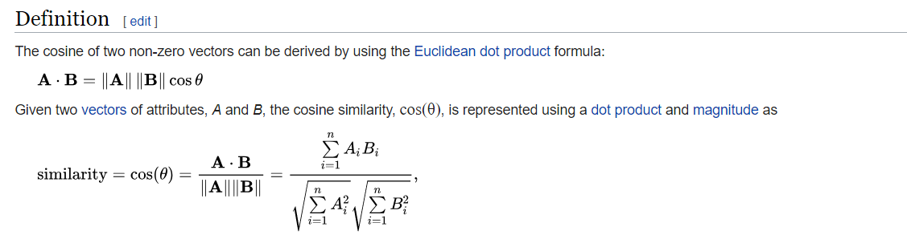
Cosine Normalization
Looks scary, but it is not.
The numerator is just the matrix multiply of the interaction matrix with each row of the co-occurrence matrix.
The denominator is just the vector length (think Pythagorean).
https://en.wikipedia.org/wiki/Cosine_similarity

Slide 29

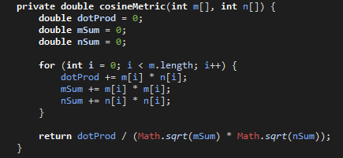
Using Cosine Normalization
Original
Recommendation
Using Cosine
Normalization
Provides a finer
resolution on the scores.

Slide 30


Issue: All Users Buy Item 0
Why recommend a product that everybody already knows about?
Popular Product
Original
Recommendation
Using Cosine
Normalization
Original
Recommendation
Using Cosine
Normalization
Cosine normalization on a popular product moves it to second last.

Slide 31


Issue: User 0 Buys all Items
Why recommend all products?
Popular User
Original
Recommendation
Using Cosine
Normalization
Original
Recommendation
Using Cosine
Normalization
Cosine normalization has the same ordering (1, 3, 7, 2) as before, but also has non-zero scores for (0, 5, 6).

Slide 32
Anomalous Relationships Recommender
(A^{T}A) -> Anomaly
Search
Engine
Product
Request
Product Request
Item
Metadata
Web
Tier
Product
Information,
Recommendations
Product Information,
Recommendations
User
Interaction
Batch Create
Co-Occurrence
Generate Importance Indicators
Add related items
to products.

Slide 33
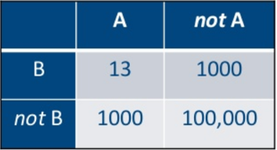
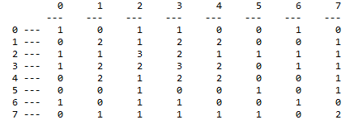

Computing Anomalous Relationships
E{}
History Matrix
Expectation Matrix
Contingency Matrix
G-Test Score
Co-Occurrence Matrix
Important Anomalous
Co-Occurrence Pairs
(0,6)
(1,2)
(2,3)
(2,4)
(2,7)
(3,7)
Selection of Most Important
Score threshold.
N highest.
Grouping/clustering.

Slide 34
Computations
After we have the co-occurrence matrix C, we need to compute “indicators” of pairs that are anomalous – important, interesting, surprising.
Math looks complicated, but the implementation is fairly easy.
Steps – given the co-occurrence matrix
1 - Compute the “contingency” matrix for each pair.
2 - Compute the “sum” matrix of the contingency matrix.
3 - Compute the “expectation” matrix of the contingency matrix.
4 - Compute G-test score for the entire contingency matrix (results in one score per value in the C matrix). Pick item pairs using this score (anomaly threshold).

Slide 35
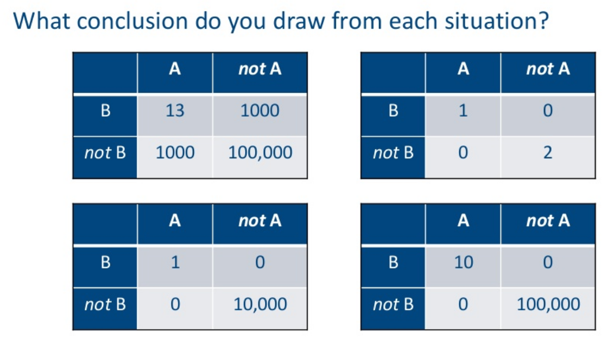
Contingency Matrix Can You Spot the Anomaly?
A and B are arbitrary pairs in the co-occurrence matrix.
i.e. “Let’s examine the relationship between items
A = 0 and B = 2”.
Four hypothetical situations…
https://www.slideshare.net/SessionsEvents/ted-dunning-chief-application-architect-mapr-at-mlconf-atl-91815

Slide 36
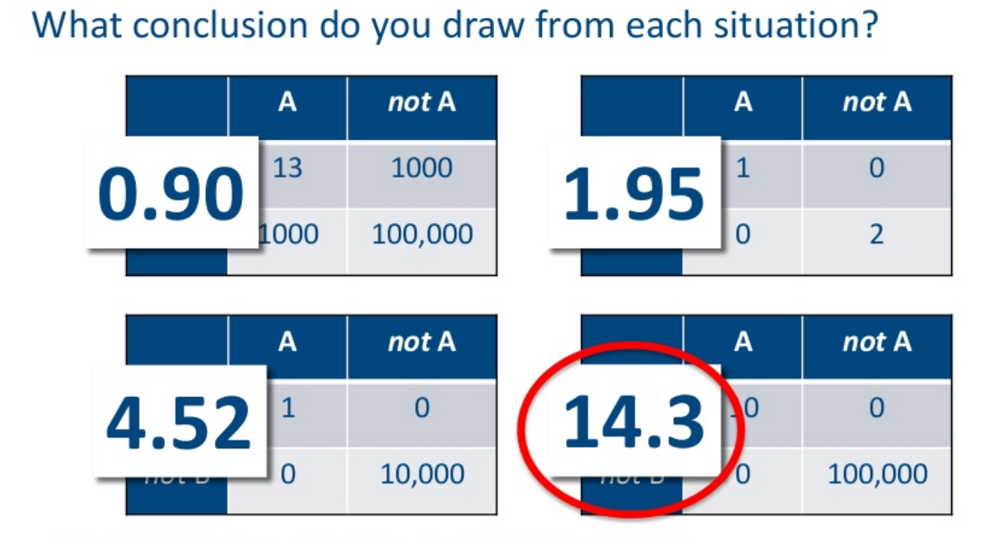
G-Test Score (aka Log Likelihood Ratio Score)
The G score is interpreted similar to a standard deviation.
https://www.slideshare.net/SessionsEvents/ted-dunning-chief-application-architect-mapr-at-mlconf-atl-91815

Slide 37
1 - Compute Contingency Matrix
The contingency matrix has 4 values per pair in the co-occurrence matrix. Note the co-occurrence matrix is symmetric and we do not use the diagonal.
Assume item A and item B, we count
A and B – A and B occur together.
A and not B – where A is combined with something other than B.
B and not A – where B is combined with something other than A.
Not A and Not B – where items other than A/B occur together.

Slide 38
2 - Example Contingency Matrix And Row/Column Sum Matrices
A and not B
A and B
C = (A^{T}A)
Contingency Matrix
B
Not B
A
1
2
3
Not A
7
11
18
8
13
21
For (A=0,B=2)
A and B: 1.
A and not B: 0 + 1 + 0 + 0 + 1 + 0 = 2.
Not A and B: 1 + 2 + 1 + 1 + 1 + 1 = 7.
Not A and Not B: Remove rows/columns 0 and 2, everything else not in a box and above the diagonal = 2 + 2 + 1 + 2 + 1 + 1 + 1 + 1 = 11.
Not A and B
Row/Column
Sum Matrix

Slide 39
3 - Expected Observation Table
Observed values.
What is the expected value?
B
Not B
(3*8)/ 21 =
1.143
(3*13) / 21 =
1.857
A
1
2
3
Not A
7
11
18
(8*18) / 21 =
6.857
(13 * 18) / 21 =
11.143
8
13
21
Example, what is the expected value of AB
We know the observed value is 1.
The expected probability assuming independency is P(A)*P(B).
P(A) = how many times we observe A / total observations. A occurred with B 1 time, A occurred with something other than B 2 times, there are 21 observations.
Thus P(A) = (1 + 2) / 21. Similarly, P(B) = (1 + 7) / 21.
Thus P(A)P(B) = ((1 + 2) / 21) * ((1 + 7) / 21)
The number of expected observations is the probability multiplied by the total number of observations Total-Count * P(A)P(B) = 3 * 8 / 21 = row-count * col-count / total.

Slide 40
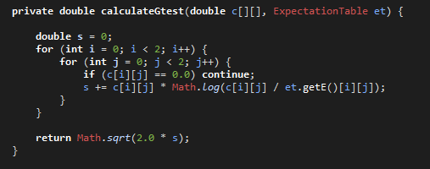
4 - G-Test
Contingency matrix “observations”
https://en.wikipedia.org/wiki/G-test
Expected observations
Result for our example - 0.1848356508203196

Slide 41
How Do We Use The G-Test?
Interpreted as a standard deviation.
Simple threshold. A typical (practical) value is 0.9 for recommendations.
Take the top N highest. We always have a few recommendations.
Group with K-means. Variable thresholding.

Slide 42
G-Test Score Distribution
Surprising relationships:
(0,6) - 0.9207849412295744
(1,2) - 1.3325766911124608
(2,3) - 1.3190718354320086
(2,4) - 1.3325766911124608
(2,7) - 0.9879856047928489
(3,7) - 1.2236855740424832

Slide 43
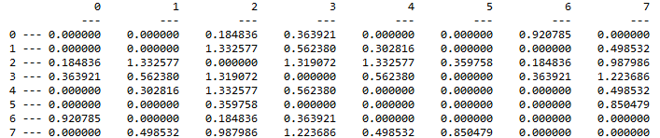
Using Fixed Threshold 0.9
Surprising relationships:
(0,6) - 0.9207849412295744
(1,2) - 1.3325766911124608
(2,3) - 1.3190718354320086
(2,4) - 1.3325766911124608
(2,7) - 0.9879856047928489
(3,7) - 1.2236855740424832
Original
Co-occurance
Matrix
G-Scores

Slide 44
Attaching Recommendations To Search Results
Surprising relationships:
(0,6) - 0.9207849412295744
(1,2) - 1.3325766911124608
(2,3) - 1.3190718354320086
(2,4) - 1.3325766911124608
(2,7) - 0.9879856047928489
(3,7) - 1.2236855740424832
Request for
product 4.
Search
Engine
Information for product 4.
Recommendation for product 2.
Assume a user is requesting item 4 from the search engine. There is a surprising relationship between items 2 and 4. Therefore we recommend item 2 in the results.

Slide 45
G-Test – All Users Buy Item 0
Original
Surprising relationships:
(0,6) - 0.9207849412295744
(1,2) - 1.3325766911124608
(2,3) - 1.3190718354320086
(2,4) - 1.3325766911124608
(2,7) - 0.9879856047928489
(3,7) - 1.2236855740424832
Surprising relationships:
(0,1) - 1.5486897274564995
(0,2) - 0.9833228031108376
(0,3) - 1.3126456125512935
(0,4) - 1.5486897274564995
(0,7) - 1.201120243417336
(1,2) - 1.3969705291984214
(2,3) - 1.4041115061633838
(2,4) - 1.3969705291984214
(2,7) - 1.155027516679629
(3,7) - 1.3197497680365102

Slide 46
G-Test Scores – User 0 Buys All Items
Original
Surprising relationships:
(0,6) - 0.9207849412295744
(1,2) - 1.3325766911124608
(2,3) - 1.3190718354320086
(2,4) - 1.3325766911124608
(2,7) - 0.9879856047928489
(3,7) - 1.2236855740424832
Surprising relationships:
(0,1) - 1.4896247468953134
(0,2) - 1.0449852971489386
(0,3) - 1.1129598785837946
(0,4) - 1.4896247468953134
(0,5) - 1.1680726320148862
(0,7) - 1.381225939709741
(1,2) - 1.6134762152328226
(1,3) - 1.490970602849331
(1,4) - 1.0365916765086622
(1,5) - 1.3178554919189398
(1,6) - 1.4896247468953134
(1,7) - 1.4616048134953632
(2,3) - 1.3891804984921465
(2,4) - 1.6134762152328226
(2,6) - 1.0449852971489386
(2,7) - 1.4813671592616886
(3,4) - 1.490970602849331
(3,5) - 1.6236709629882806
(3,6) - 1.1129598785837946
(3,7) - 1.8935118972179625
(4,5) - 1.3178554919189398
(4,6) - 1.4896247468953134
(4,7) - 1.4616048134953632
(5,6) - 1.1680726320148862
(6,7) - 1.381225939709741

Slide 47
Performance Considerations
Need to reduce the size of the co-occurence matrix.
Remove users who buy too much.
Remove items that are too popular.
Limit the “window” to only the last N interactions.

Slide 48
Improvement Breakthroughs
Was it fancy mathematics, statistics, algorithms…
No.
Three things
Dithering.
Anti-Flooding.
Multi-modal.

Slide 49
Dithering
Users typically don’t look beyond the first page of results
Don’t scroll.
Don’t go to next pages.
Recommendation engine is evaluated on results it is always returning. Stagnates at initial performance level.
One method
Take the result list and generate a score that is the log of the initial rank.
Add some normally distributed random noise.
Sort according to the new score.

Slide 50
Anti-Flooding
Flooding
Too much of a good thing.
Gives many similar recommendations.
Solution
Reorder the results to make them appear more diverse.
Penalize the rank of any result that appears too similar to higher rated results.

Slide 51
Multi-Modal
Many types of “interactions” – user behaviors
Buying – user-id, buy, item-id.
Viewing – user-id, view, item-id.
Category-preference – user-id, cat-pref, item-id.
Sharing – user-id, share, item-id.
Search – user-id, search, keyword.
Many additional behaviors even on a simple web site. Virtually anything we know about a user can be used to improve recommendations.
Additional modal information appears as additional interactions. The A matrix grows horizontally.

Slide 52
Example of Multi-Modal Data
Product
Categories
Products
Products
Products
Terms
User-i
Purchases
Views
Category
Shared
Search
Terms
Interaction Vector
Users
Extended A Matrix

Slide 53
Continuous (Streaming) Updates
Search
Engine
Product
Request
Product Request
Item
Metadata
Web
Tier
Product
Information,
Recommendations
Product Information,
Recommendations
User
Interaction
Incremental Updated
Cooccurance
Generate Importance Indicators
Add related items
to products.
Modify “Batch Create Cooccurrence” to be an “Incremental Updated Cooccurrence”.
Updated counters in matrix.
Only a subset will change the important indicator lists.
Very efficient.

Slide 54
Additional Reading
Building A Simple Recommender https://mapr.com/blog/building-a-simple-recommender/
Practical Machine Learning https://mapr.com/practical-machine-learning/assets/practical-machine-learning.pdf
An Inside Look at the Components of a Recommendation Engine https://mapr.com/blog/inside-look-at-components-of-recommendation-engine/
Exploring Co-Occurrence Matrices and Recommenders https://mapr.com/practical-machine-learning/assets/practical-machine-learning.pdf

Slide 55
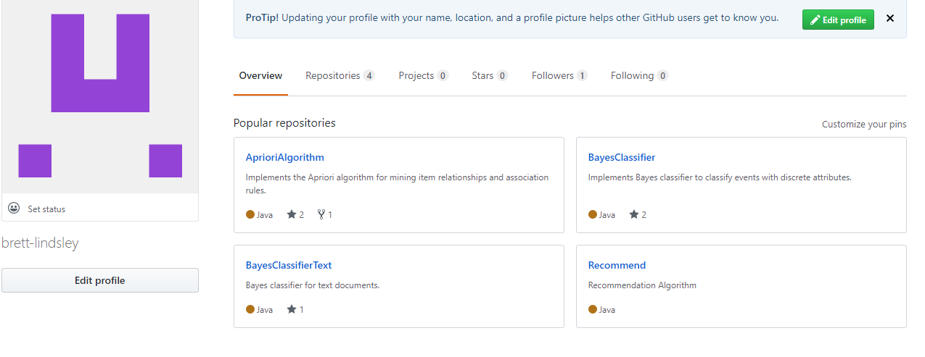
Code
https://github.com/brett-lindsley

